Slide 1
Online Book Reselling
Supervisor: Tauseef Ahmed

Slide 2
GROUP MEMBERS
SYED MUHAMMAD FARIS ALI (FA17-BSCS-0024)
MUHAMMAD YOUNUS (FA17-BSCS-0066)
SYED RAHMEER (FA16-BSCS-0061)

Slide 3
Introduction
It’s a web-based application that helps the needy user to buy or sell used books. A user can take pictures of their books and upload them to the website. The buyer can search either by author name or book title or by subject. It cover the schools, universities and people who are avid traveling.
Online Book reselling (OBR) application also enable shop vendors to open online book store through our site

Slide 4
objective
AS WE KNOW THAT BOOK READING IS AN ESSENTIAL PART OF KNOWLEDGE. READING REGULARLY IS A HABIT OF COUNTLESS PEOPLE. STUDENTS OF SCHOOLS OR UNIVERSITY BUY COSTLY BOOKS AND WHEN THE SEMESTER IS DONE OR WHEN THEY MOVE TO HIGHER STANDARD BOOKS BECOME MORE OR LESS NOT USEFUL FOR THEM. BUYING NEW BOOK TO READ AND WHEN PEOPLE DONE WITH IT THEN IT'S BETTER TO SELL IT.
problem statement
in the Pakistan market, there is no platform which is primarily based on selling and buying used books for all level of students. if a student passed 7th class and he needs to buy books for 8th class but it costs. to reduce their cost and time there should be a platform that helps them to buy used course books and to sell their previous books which they already done with. more or less the same for university and college-level students. people who love to read novels and other books and cannot buy it because of the cost. to facilitate them there should a platform.

Slide 5
Scope Of Project
Recommendation using new approach
View Activity
Search by Author, Book title, Subject.
Add to wish List
Identity Provider
Book status (New/used)
Category
Facility to user feed back

Slide 6
ACCOMPLISH

Slide 7
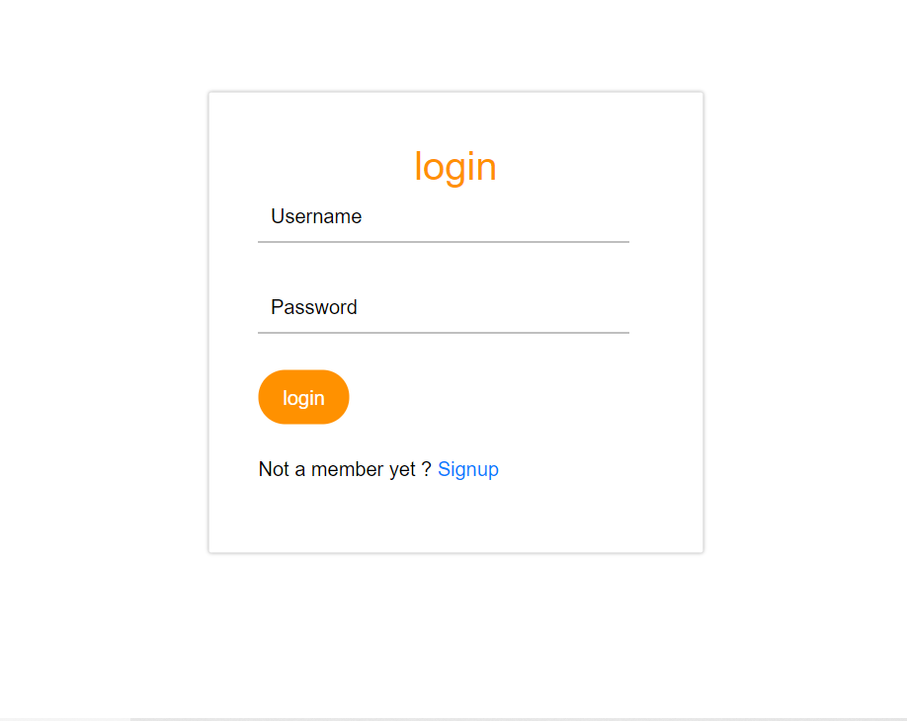
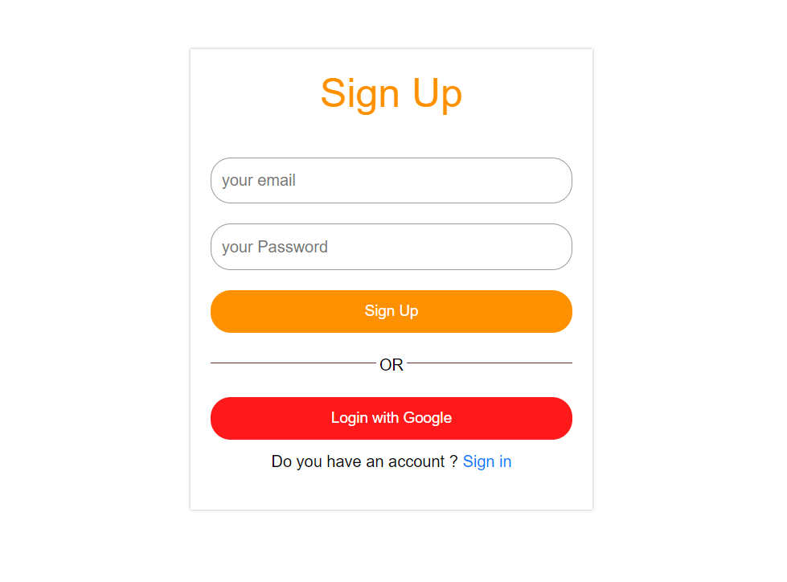

Slide 8
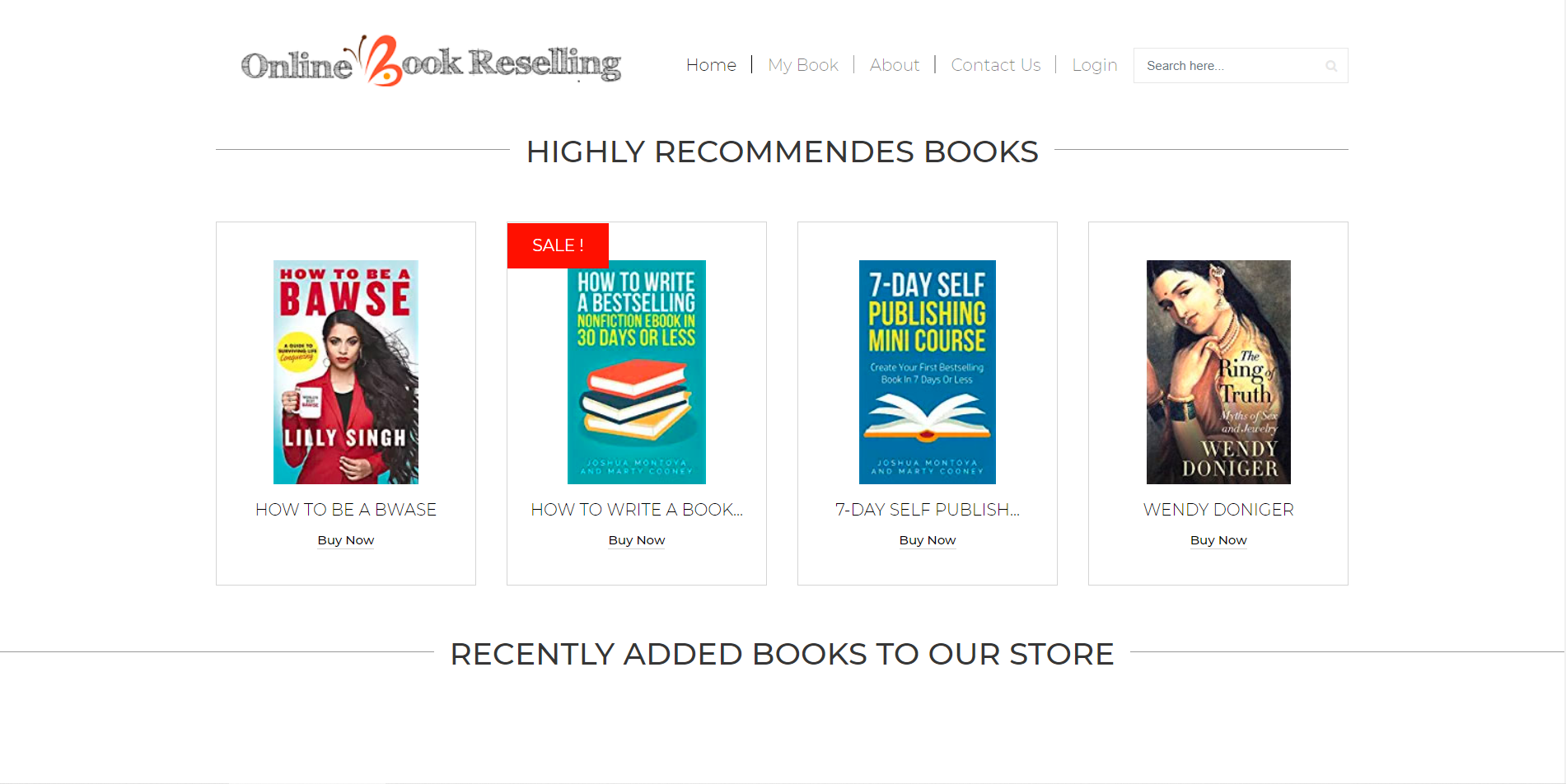

Slide 9
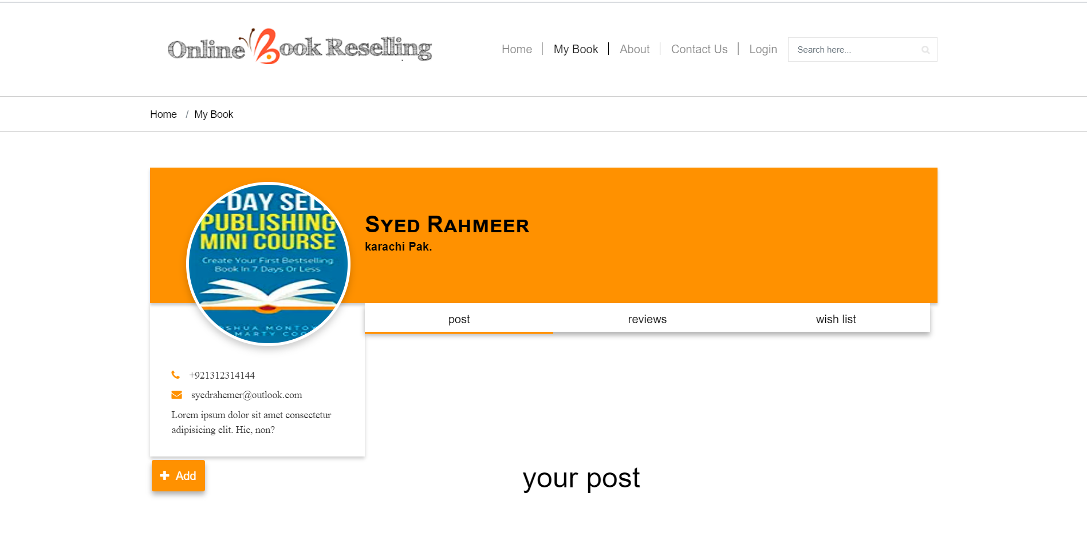

Slide 10
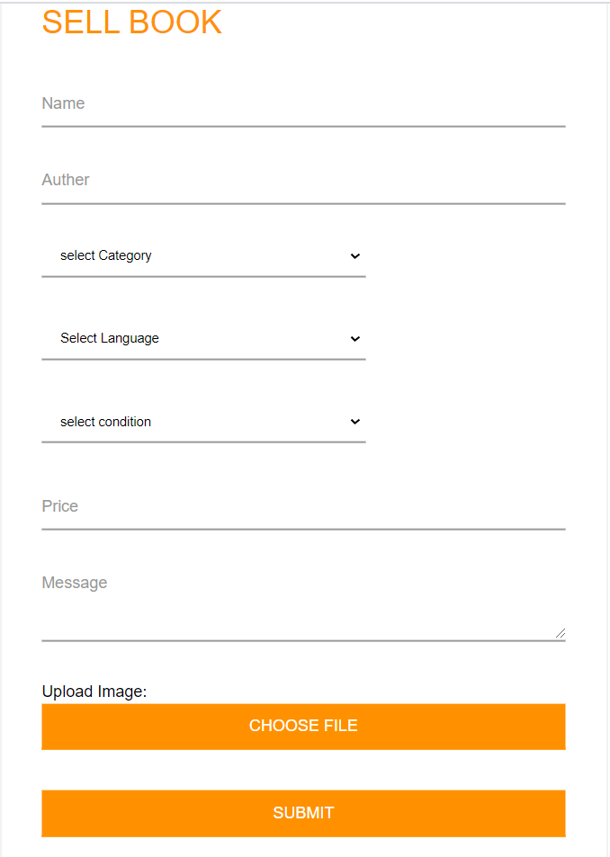
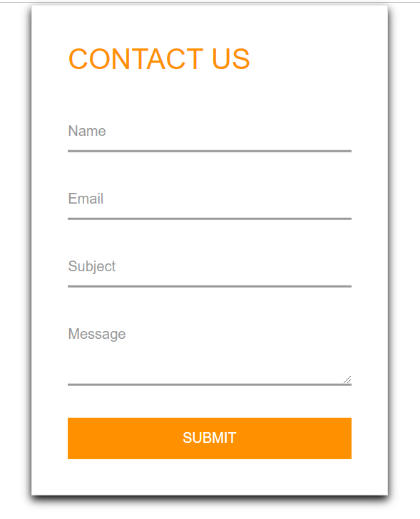

Slide 11


